Slide 1
Alard College of Engineering and Management B.E. Computer Engineering Academic Year 2023-24
Presentation on
“Face Sketch Creation And Recognition”
By
Abhishek Gavhane(18)
Mayur Shinde(34)
Sanket Kale(25)
Pramod Rumale(40)
Guided By:-
“Prof. Anoop Kushwaha”

Slide 2
Contents
Introduction
Problem Statement
Objectives of the Project
Literature Survey
Flow Diagram
Algorithm
System Requirement
Conclusion

Slide 3
Introduction
A criminal can be easily identified and brought to justice using a face sketch drawn based on the description provided by the eye-witness, however in this world of modernization, the traditional way of hand drawing a sketch is not found to be that effective and time-saving when used for matching and identifying from the already available database or real-time databases.
We aim to create an application that allows users to select individual features or upload hand-drawn features. The application utilizes deep learning and cloud infrastructure for efficient matching and recognition. Machine learning algorithm suggests relevant facial features.

Slide 4
Problem Statement
To develop an application for Face Sketch Creation and Recognition

Slide 5
Objectives of the Project
The primary objectives of this project are as follows:
Develop a user-friendly interface for capturing textual descriptions of faces.
Implement facial sketch construction algorithms to convert textual descriptions into visual sketches.
Utilize AWS services, such as Amazon Rekognition, for facial recognition based on the constructed sketches.
Integrate the constructed sketches and recognition results into a system.

Slide 6
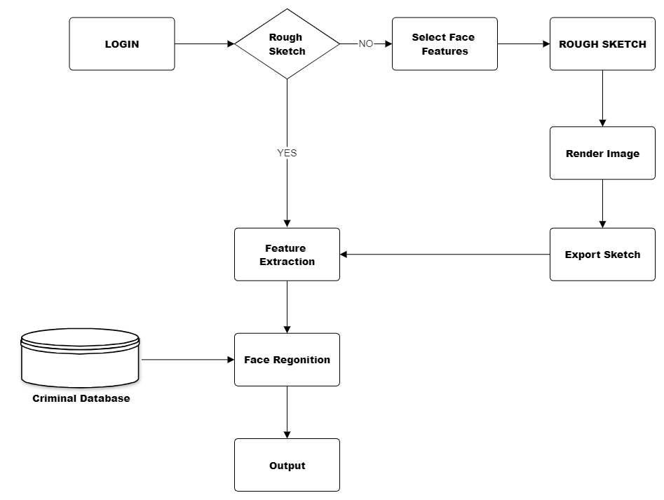
Flow Diagram

Slide 7
Algorithm Used For Proposed System
Amazon Rekognition: It is a cloud-based image and video analysis service that makes it easy to add advanced computer vision capabilities to our applications.
It is offered by AWS. It's a deep-learning-based service that makes it easy to add video and image analysis to applications. Amazon Rekognition is a machine learning product by AWS that helps in adding image and video analysis to applications. It uses deep learning to analyze images and videos.

Slide 8
Algorithm Used For Proposed System
Amazon Rekognition works with two KPI (Key performance Indicator) sets – Amazon Rekognition Image and Amazon Rekognition Video. These KPIs help in image and video analysis respectively. These KPIs analyze images and videos to generate insights that you can use in your apps. When your customer uploads a photo, Amazon Rekognition can detect objects or faces in that image.

Slide 9
System Requirements
IDE: NetBeans IDE for Java application development.
Front-End Development: JavaFX
Back-End Development: Java 8 for Server-Side Programming
Amazon Rekognition with API
AWS S3 for File Storage
Additional Technology: OTP Generation, Version Control, Security and Deployment.

Slide 10
Conclusion
In conclusion, forensic sketching is an important tool in criminal investigations that can help identify suspects based on eyewitness accounts.
The process of creating a forensic sketch involves an initial interview with the witness or victim, followed by using various techniques to create a sketch that accurately represents the suspect’s appearance.
However, forensic sketching can also pose challenges, such as difficulties in recalling details of the suspect's appearance and subjective interpretation of the sketch by the artist.

